Slide 1
Imaging Near-surface Heterogeneities by Natural Migration of Surface Waves
Zhaolun Liu¹, Abdullah AlTheyab^{1, 2}, Sherif M. Hanafy¹ and Gerard Schuster¹
1. King Abdullah University of Science and Technology
2. Presently Saudi Aramco, Saudi Arabia.
Notes:
Good morning, everyone. My topic is Imaging ~.

Slide 2

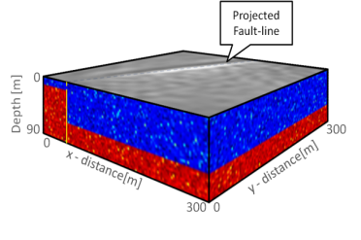
Outline
0
Introduction
Theory
Workflow
Numerical Tests
  3D Synthetic Data
  2D Aqaba Data
  3D Qademah Data
Conclusions
Depth (m)
90
300
0
X (m)
300
0
Y (m)
0
Y
z (m)
y (m)
Z
0
x (m)
X
0
Notes:
This is my outline. First is the introduction. Then is the theory part, workflow, next is numerical tests and finally is the conclusion.

Slide 3
Outline
0
Introduction
Theory
Workflow
Numerical Tests
  3D Synthetic Data
  2D Aqaba Data
  3D Qademah Data
Conclusions
Depth (m)
90
300
0
X (m)
300
0
Y (m)
Notes:
First is the introduction.

Slide 4

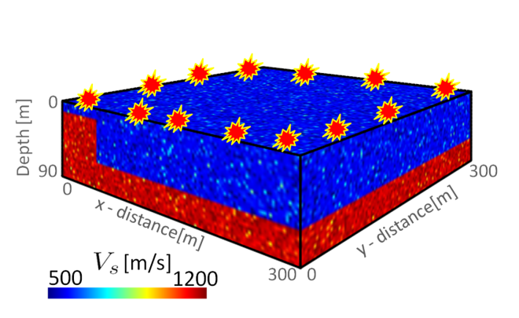
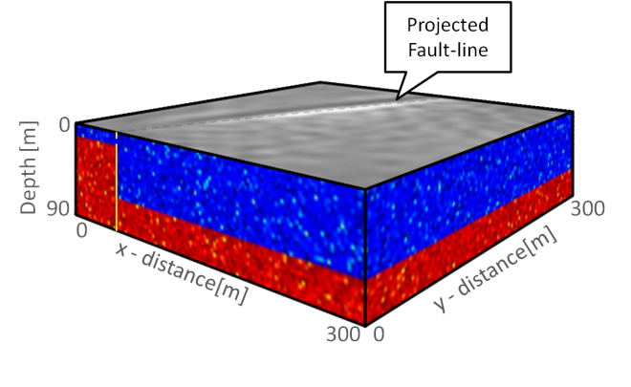
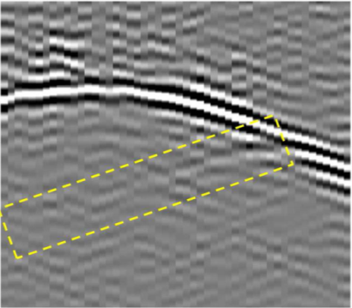
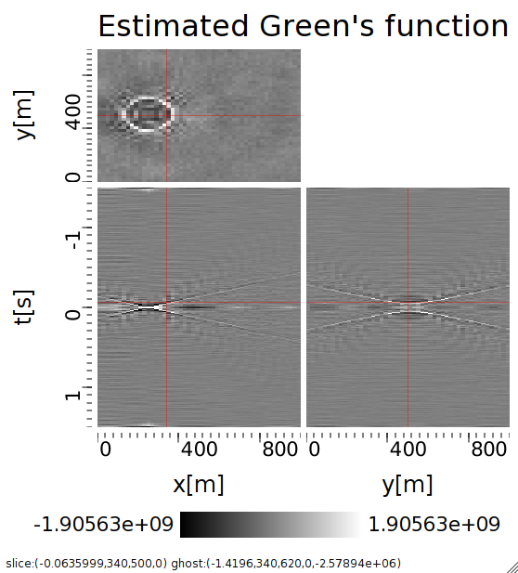
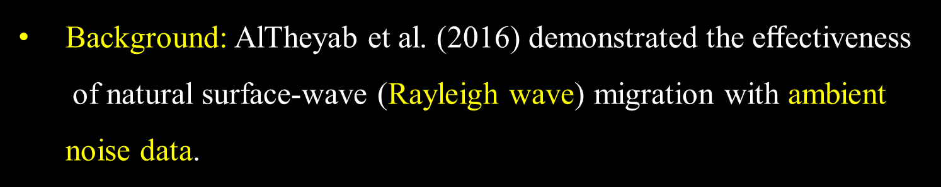
Introduction
Background: AlTheyab et al. (2016) demonstrated the eﬀectiveness of natural surface-wave (Rayleigh wave) migration with ambient noise data.
0
Distance (m)
300
Ambient noise cross-correlation
Natural migration
0
0
0
Depth (m)
90
300
Time (s)
Depth (m)
0
90
300
X (m)
Y (m)
0
X (m)
Y (m)
300
0
300
0
500
1200
1
Vs (m/s)
Natural migration image
Empirical Green’s function
  Benefits: No velocity model is needed but ambient noise data
  weak signal-to-noise ratio?
Question: Can controlled source surface-wave migration do better?
Notes:
Abdullah demonstrated the effectiveness of natural surface-wave migration with ambient noise data. This is a velocity model. Through ambient noise cross-correlation, we can get the empirical Green’s function. And then do the natural migration, we can get the natural migration image. We can see the projected fault line at surface.
The benefit is that no velocity model is needed but ambient noise data weak signal-to-noise ratio.
The Question is that, can controlled source surface-wave migration do better?

Slide 5
Goal
Test effectiveness of using controlled source data and natural migration of surface waves in delineating shallow faults
1
5.2
6
7.1
z (m)
Filter No.
Pseudo depth (m)
30
11
240
7
y (m)
240
240
19.5
0
0
x (m)
y (m)
0
0
x (m)
240
Notes:
Our goal is to test effectiveness of using controlled source data and natural migration of surface waves in delineating shallow faults

Slide 6
Outline
Introduction
Theory
Workflow
Numerical Tests
  3D Synthetic Data
  2D Aqaba Data
  3D Qademah Data
Conclusions
0
Y
z (m)
y (m)
Z
0
0
x (m)
X
Notes:
Then is the theory part.

Slide 7

Natural Migration Equation (Rayleigh Waves)
In frequency domain,
Common shot gather G(s|x)
Note:
3D data → 2D image
2D data → 1D image
Wavefront at t1
Y
B
g
x
t3
t4
t2
y (m)
t1
0
Migration Image
0
x (m)
X
s
$$λ/2$$
G(x|g)
Y
0
t1
t2
Y
t3
t4
y (m)
z (m)
Y
y (m)
0
0
0
x (m)
X
Z
y (m)
0
x (m)
X
0
X
0
d(s|g)^{scatt}
x (m)
Y
t7
t6
t5
t4
y (m)
X
0
0
x (m)
Notes:
This is the natural Migration equation in fre domain. To introduce this equation, we use this simple model. There is a scatter within half the domain wavelength of surface wave. This is the position projected on the surface. There is a dense source and receiver array on the surface. B is referred as the source and receiver array. X is limited in B. s is the source position. We can get the surface-wave Green’s function from s to x. When the surface wave propagate at the scatter’s position, there will be backscattered wave. We can also get the Green’s fun. From g to x. By apply this migration equation, we can get the migration image at surface.
Note that 3D data can only get 2D image. 2D data can only get 1D image.

Slide 8
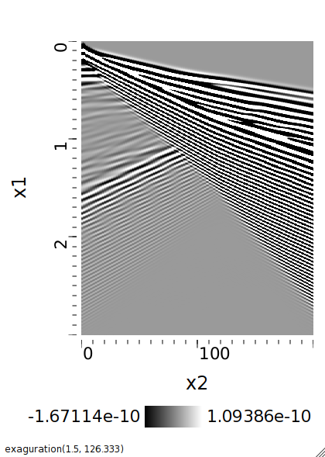
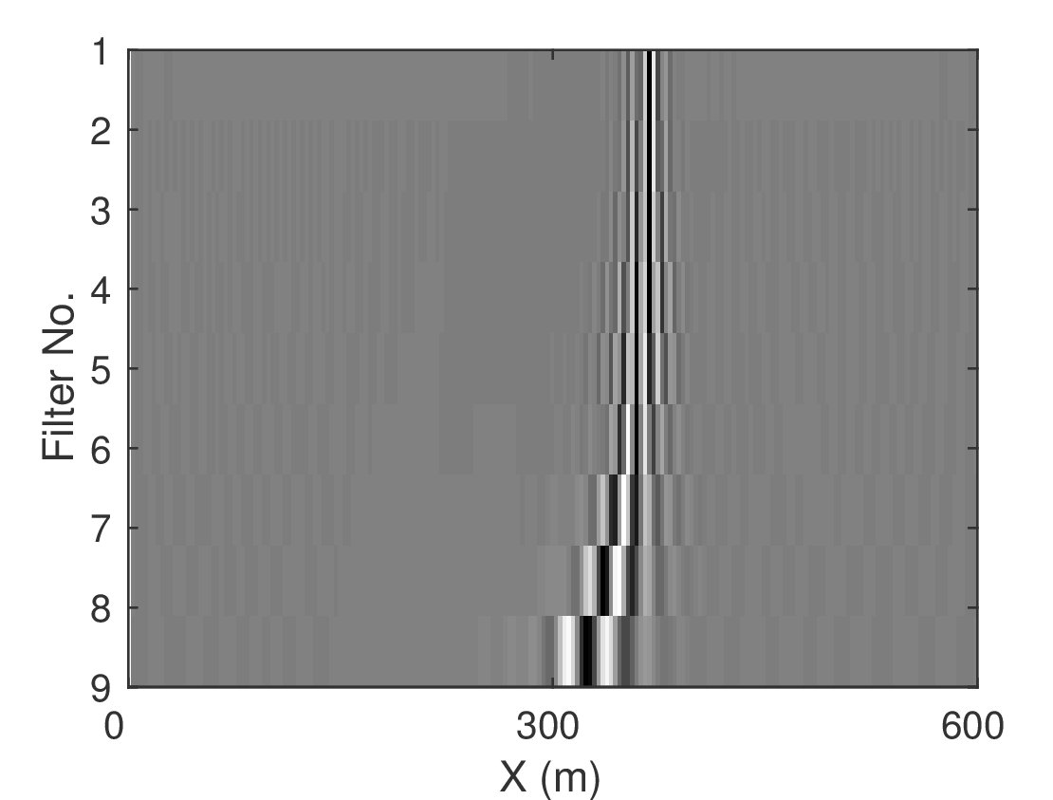

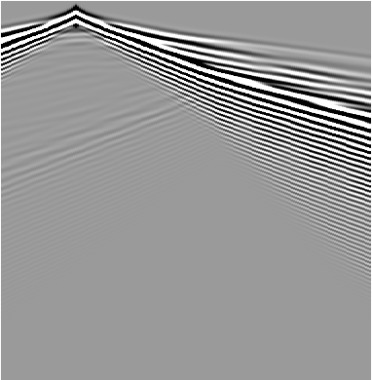
Natural Migration Equation (Rayleigh Waves)
In frequency domain,
2D data → 1D image
Common Shot Gather
G(s|x)
0
x (m)
600
0
B
s
g
t (s)
Migration Image
0
d(s|g)^{scatt}
3
0
x (m)
600
0
x (m)
600
0
G(x|g)
Q: How to get images at different depths?
t (s)
3
Notes:
This is a 2D example; This is CSG; this is 1D migration image. The question is how to get images at different depths?

Slide 9
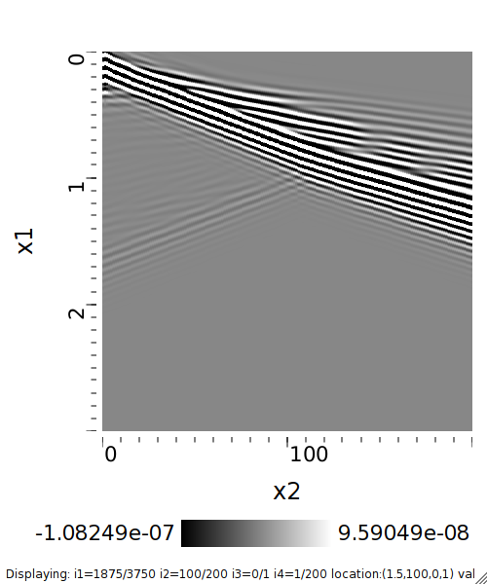
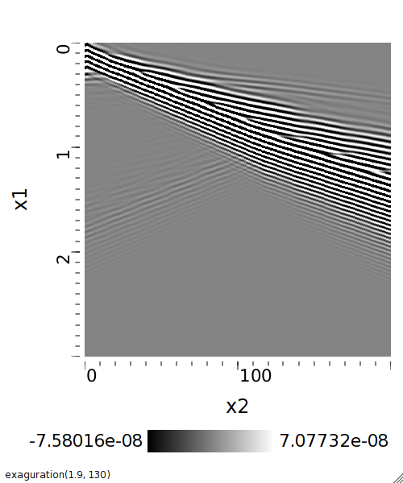
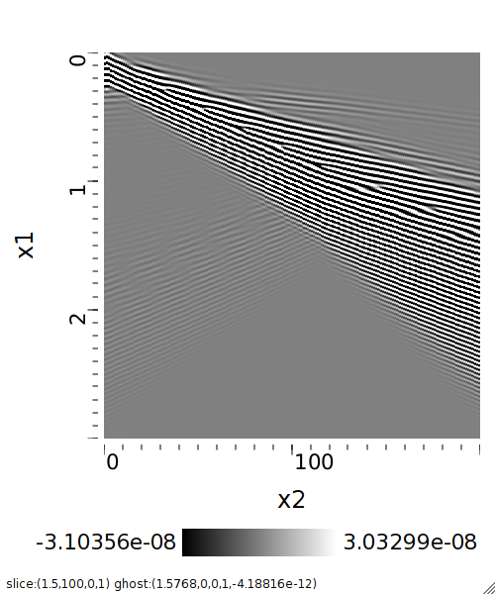
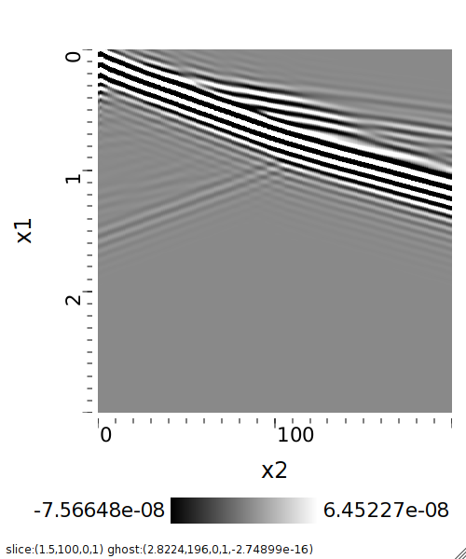

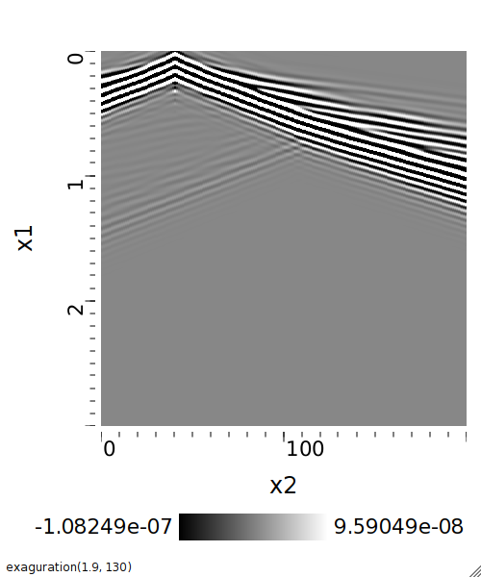

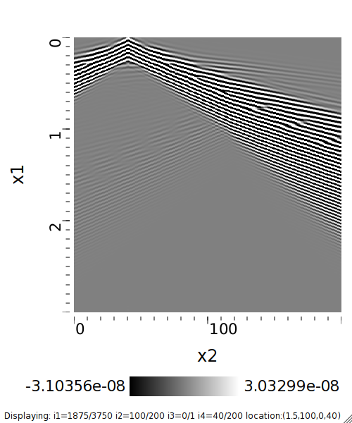

Depth Estimation from Surface
Answer: narrow-band filters
G(s|x)
0
Filter 3
x (m)
Filter 2
x (m)
Filter 1
x (m)
Filter 4
x (m)
0
x (m)
600
0
600
0
0
600
0
600
600
0
z (m)
0
0
0
0
Bandpass
(CSG)
40
G(s|x)
0
x (m)
600
0
x (m)
600
t (s)
t (s)
t (s)
t (s)
0
t (s)
0
Migration Images
3
3
3
3
3
t (s)
1
7
d(s|g)^{scatt}
2
9
z (m)
0
x (m)
600
G(x|g)
Filter no.
Pseudo depth (m)
Filter 4
x (m)
Filter 3
x (m)
Filter 2
x (m)
Filter 1
x (m)
d(s|g)^{scatt}
3
12
0
600
0
40
x (m)
3
4
18
0
600
0
600
0
0
600
600
0
0
0
0
0
x (m)
600
0
x (m)
600
Bandpass
0
G(x|g)
Pseudo depth= $λ$_{n}/3
$λ$_{n}← Dispersion curve
t (s)
t (s)
t (s)
t (s)
t (s)
Q: How to get images at different depths?
t (s)
3
3
3
3
3
3
Notes:
The answer is narrow-band filters. Firstly, we use a filter with a higher center fre to detect the lateral velocity anomaly at shallow part . Then, we decrease the center frequency of the filter to detect the deeper part velocity anomaly. Here we use four filters to get four migration images. Then, we can estimate the pseudo depth according to this rule of thumb lambda/3, where lambda is estimated from the dispersion curve. Then, we can map the migration images to different depth.

Slide 10
Outline
Introduction
Theory
Workflow
Numerical Tests
  3D synthetic data
  2D Aqaba data
  3D Qademah data
Conclusion
Notes:
Next is workflow.

Slide 11
Workflow
G₂(s|x)
x (m)
0
600
0
t (s)
3
Collected data G(s|x)
G(s|x)
G₁(s|x)
x (m)
0
x (m)
600
0
600
G₃(s|x)
x (m)
0
0
0
600
Filter
0
For filter no. k= 1,…,n
t (s)
t (s)
t (s)
Filtered data G_{k}(s|x)
3
3
3
G₄(s|x)
x (m)
m_{k}(x)
0
600
Migration Images
0
1
7
Yes
More filters?
2
x (m)
9
0
600
t (s)
Filter no.
Pseudo depth
3
12
No
4
18
3
Pseudo-depth estimation
End
Notes:
We start from the collected data. And then do a for loop according the filter no. We can get the filter data and do natural migration to get the migration image. If we have more filters, we continue the for loop. If no, we do the pseudo-depth estimation and finally the end.

Slide 12
Outline
Introduction
Theory
Workflow
Numerical Tests
  3D Synthetic Data
  2D Aqaba Data
  3D Qademah Data
Conclusions
Notes:
Next is 3D synthtic data test

Slide 13
3D Synthetic Data
S-wave Velocity Model
Common Shot Gather
Source and receiver array
Km /s
1.15
0
z (m)
0.95
63
240
300
y (m)
240
0.7
129
174
0
x (m)
30 by 15 source and receiver array
Dominant frequency: 20 Hz
Receiver interval: dx=10 m; dy=20 m
Buried Fault location: z=6 m
Notes:
This is s-wave velocity. The fault is at the depth of 6 meter. This is one of Common shot gather.

Slide 14
3D Synthetic Data
Migration Images
S-wave Velocity Model
Common Shot Gather
Common Shot Gather
45 Hz
1
300
5.2
6
2
y (m)
0
300
0
x (m)
3
z (m)
7.1
4
Filter No.
30
5
Pseudo depth (m)
11
240
300
6
300
y (m)
240
7
0
0
x (m)
15Hz
19.5
Notes:
By applying seven filter we can get these seven migration images. The center frequencies are changing from 45Hz to 15Hz. This is the pseudo-depth. This is part of the velocity model. We can see that the red dashed lines delineate the position of the fault.

Slide 15
Outline
Introduction
Theory
Workflow
Numerical Tests
  3D Synthetic Data
  2D Aqaba Data
  3D Qademah Data
Conclusions
Notes:
Next is 2D aqaba data test

Slide 16
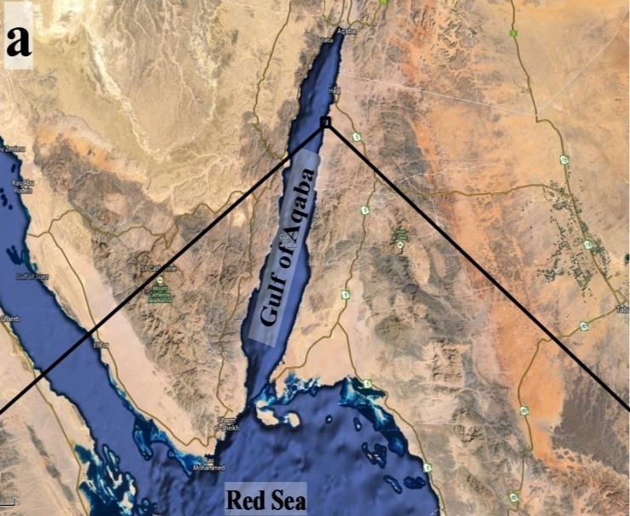
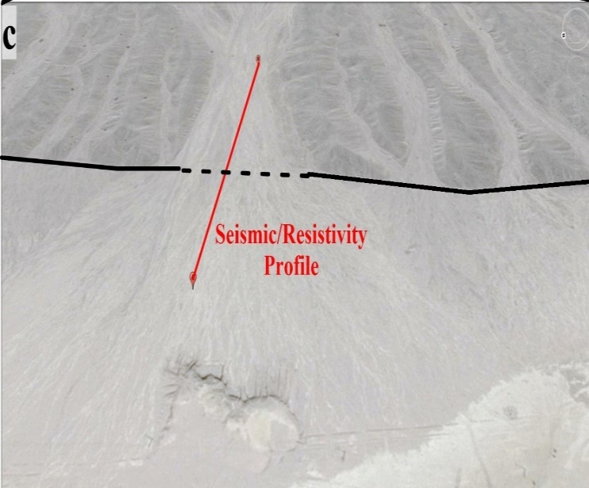
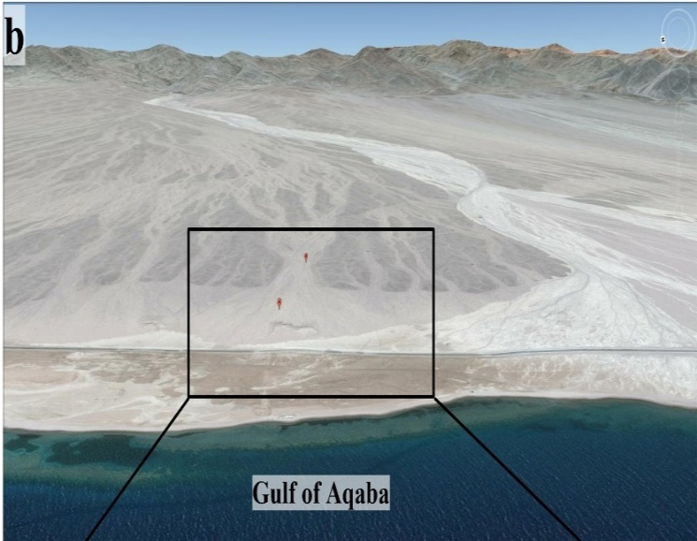
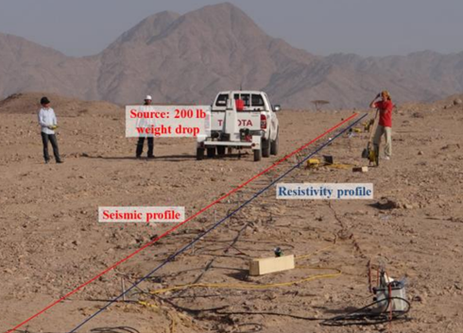
2D Aqaba Data
Study area
120 receivers
120 sources
2.5 m spacing
Notes:
A 2D land survey was carried out along Gulf of Aqaba.
This is the google map of the study area. This is the picture with people on the field
There are 120 receivers and 120 sources. The source is located at each receiver. 2.5m spacing.

Slide 17
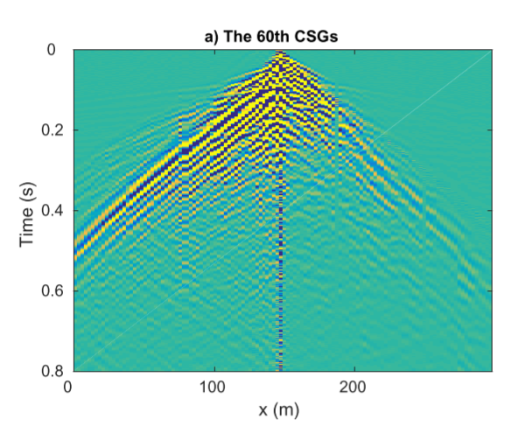
2D Aqaba Data
Common Shot Gather
Migration Image
X (m)
0
150
300
55 Hz
0
2.0
1
Narrow-band filters
0
150
300
3
X (m)
2.8
Pseudo depth (m)
Time (s)
Filter No.
6
3.9
Natural Migration
0.4
9
8.0
15Hz
0
150
300
X (m)
0.8
Notes:
This is a typical common shot gather. By applying several narrow-band filters and do natural migration, we can get the migration images for different filters. The center frequencies are changing from 55Hz to 15Hz. This is pseudo depths we estimate.

Slide 18
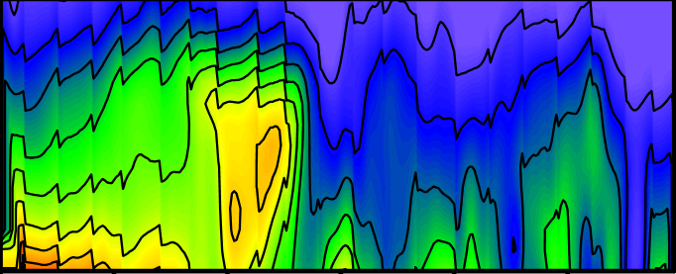
2D Aqaba Data
Traveltime Tomogram
Migration Image
55 Hz
0
Km/s
1
2.0
2
0.3
1
3
2.8
3
4
2
Pseudo depth (m)
5
1
Depth (m)
Filter No.
4
6
3
3.9
1.3
14
9
8.0
0
150
300
15Hz
0
150
300
X (m)
X (m)
Location 2: surface expressed fault (ground true)
Locations 1: lateral velocity anomaly
Locations 3 and 4: low velocity zones
Notes:
Then, we try to interpret the migration images by comparison with traveltime tomogram. Location 2 is the surface expressed fault, which is a ground true. There is strong lateral velocity anomaly at Location 1. There are low velocity zones at location 3 and 4.

Slide 19
2D Aqaba Data
Common Offset Gather (7.5 m)
Migration Image
55 Hz
0
1
2.0
3
2.8
2
Pseudo depth (m)
Time (s)
Filter No.
4
0.2
6
3
3.9
4
9
8.0
0
150
3
300
15Hz
0
150
300
2
X (m)
X (m)
Location 2: surface expressed strike-slip fault (ground true)
Locations 3 and 4: low velocity zones
Notes:
Then, compare the migration images with the common offset gather. From common offset gather, we can see clearly that location 2 exists a break of seismic event and there are low velocity zones at location 3 and 4.

Slide 20
Outline
Introduction
Theory
Workflow
Numerical Tests
  3D Synthetic Data
  2D Aqaba Data
  3D Qademah Data
Conclusions
Notes:
Next is 3D Qademah Data test.

Slide 21
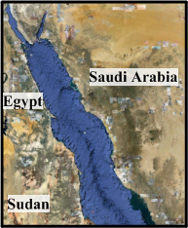
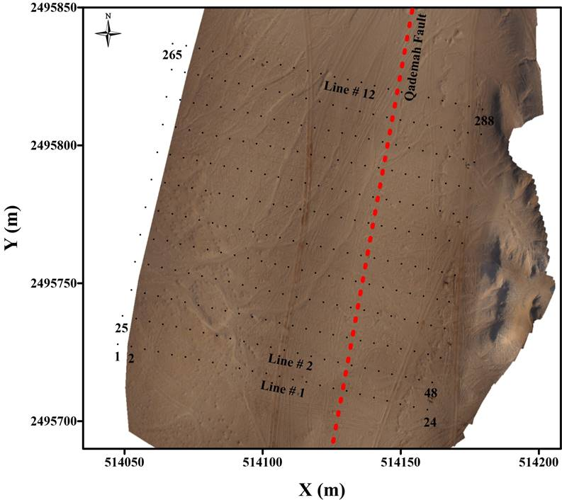
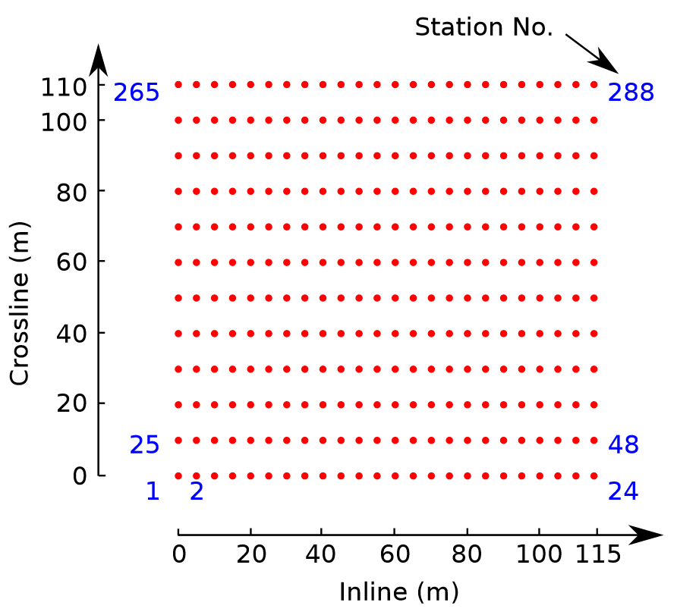
3D Qademah Data
Notes:
A 3D land survey was carried out along the Red Sea coast over the Qademah fault system.
This is the google map of the study area. We zoom the location and can see the receiver geometry. There were 288 receivers arranged in 12 parallel lines, and each line has 24 receivers. The inline receiver interval is 5 m and the crossline interval is 10 m.

Slide 22

3D Qademah Data
A Typical 3D Shot Gather
Migration Images
41Hz
0
1
1.4
Narrow-band filters
2.1
Time (s)
Filter No.
3.3
Natural Migration
Pseudo depth (m)
5.1
0.7
8
1
Receiver
288
15 Hz
110
105
y (m)
0
0
x (m)
Notes:
This is a typical common shot gather. By applying several narrow-band filters and natural migration, we can get the migration images. The center frequencies are changing from 41Hz to 15Hz. This is pseudo depth.

Slide 23
3D Qademah Data
Rayleigh Phase Velocity Tomogram
Migration Images
km/s
41Hz
0.6
1
1.4
29
2.1
Frequency (Hz)
Filter No.
3.3
Pseudo depth (m)
15
5.1
110
8
105
15 Hz
110
105
y (m)
0
x (m)
0.3
0
0
x (m)
0
y (m)
Qademah fault is buried because of erosion.
Notes:
This is Rayleigh phase velocity tomogram. The blue area show the position of the Qademah fault.

Slide 24
Outline
Introduction
Theory
Workflow
Numerical Tests
  3D Synthetic Data
  2D Aqaba Data
  3D Qademah Data
Conclusions
Notes:
Finally is the conclusion.

Slide 25
Conclusions
The natural migration (NM) method is effective for controlled source data.
1
1
1.4
5.2
2.1
7.1
Filter No.
Filter No.
3.3
Pseudo depth (m)
Pseudo depth (m)
11
7
5.1
8
More accurate hazard maps can be obtained in a cost-effective manner.
240
19.5
110
y (m)
0
0
x (m)
240
0
105
y (m)
0
x (m)
Notes:
The natural migration (NM) method is effective for controlled source data. Our results imply that more accurate hazard maps can be obtained in a cost-effective manner.

Slide 26
Conclusions
Limit:
A dense receiver coverage is needed .
Next:
The use of least squares migration in mitigating the artifacts.
Notes:
A limitation of surface-wave migration is that a dense receiver coverage is needed. In the future, we may try to use least squares migration to mitigate some artifacts in the migration image.

Slide 27










Acknowledgements
Sponsors of the CSIM (csim.kaust.edu.sa) consortium.
KAUST Supercomputing Laboratory (KSL) and IT research computing group.
Notes:
[kənˈsɔrtiəm]

