Slide 1
An optimized implicit ﬁnite-difference scheme for the two-dimensional Helmholtz equation
Zhaolun Liu
Notes:
Next, I will give u an report about the “”

Slide 2
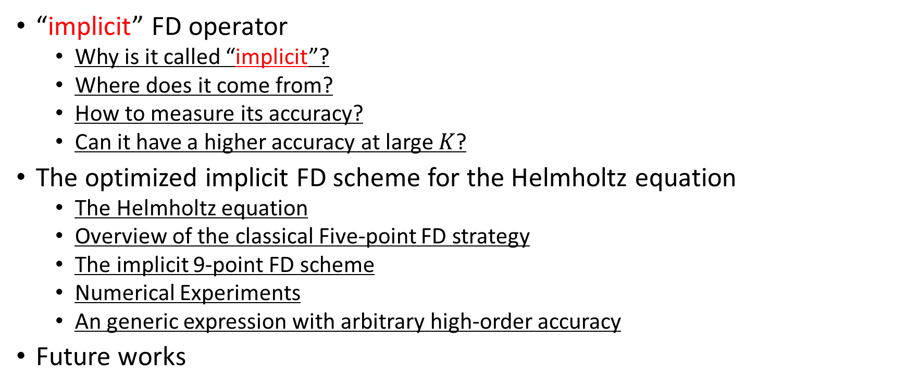
Outline
“implicit” FD operator
  Why is it called “implicit”?
  Where does it come from?
  How to measure its accuracy?
  Can it have a higher accuracy at large $K$?
The optimized implicit FD scheme for the Helmholtz equation
  The Helmholtz equation
  Overview of the classical Five-point FD strategy
  The implicit 9-point FD scheme
  Numerical Experiments
  An generic expression with arbitrary high-order accuracy
Future works
Notes:
This is outline

Slide 3
“implicit” FD operator
A simple example of explicit FD operator: the central difference operator
A simple example of implicit FD operator
Notes:
First, I will introduce the implicit FD operator.
Before that, I will intrtoduce the explicit FD operator. It is also called “ the central difference operator”
This is a simple example of explicit FD operator for the 2th order derivative of p with respect to x.
Then I give u a simple example of implicit FD operator. We can see, it involves central difference operator.

Slide 4
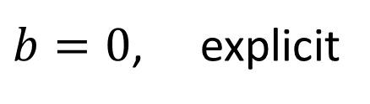
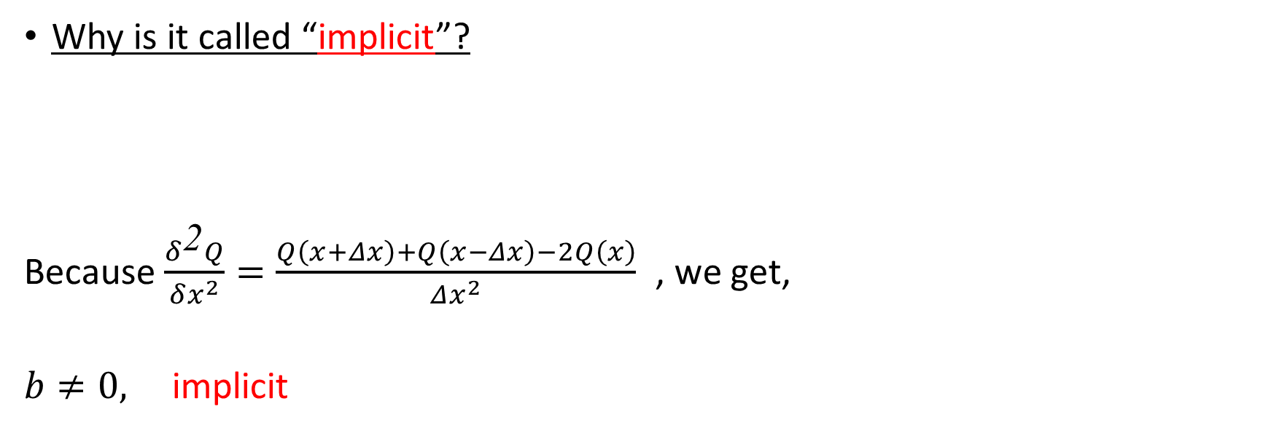
“implicit” FD operator
Why is it called “implicit”?
Because $\frac{δ^{\text{2}}Q}{δx^{2}}=\frac{Q\left(x+Δx\right)+Q\left(x−Δx\right)−2Q\left(x\right)}{Δx^{2}}$ , we get,
$b≠0,$ implicit
multiplied by the
denominator
$b=0$, explicit
Notes:
So, why is it called implicit? numerator
To figure it out, we firstly let the derivative equal to uppercase Q,
and then multiply Both sides of this formula by the denominator, and we get this one.
Because the derivative of uppercase Q can be expressed as this formula. Then ,we get this formula.
As we know that our goad is to calculate the value of uppercase Q at position x by the value of p at difference position.
However from this equation, we can see that to calculate Q, we not only need the value of p, also the value of Q at x plus delta x, x
Compared with the explicit FD operator, no need to Q at other position

Slide 5

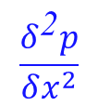
“implicit” FD operator
Where does it come from?
  Taylor series expansion(TE)
  Add the above two equations
$$\frac{δ^{\text{2}}p}{δx^{2}}$$
equal
$$\frac{δ^{\text{2}}}{δx^{2}}$$
approximate
Notes:
We take the Taylor series expansion of a function P at x+mdx and x-mdx. Move this 2P(x) to the left hand side and both sides of the equation divide the square of x. And extract the second partial differential of P, we can get this formula. This term is equal to the central FD operator and this term can be approximated by the central FD operator.

Slide 6
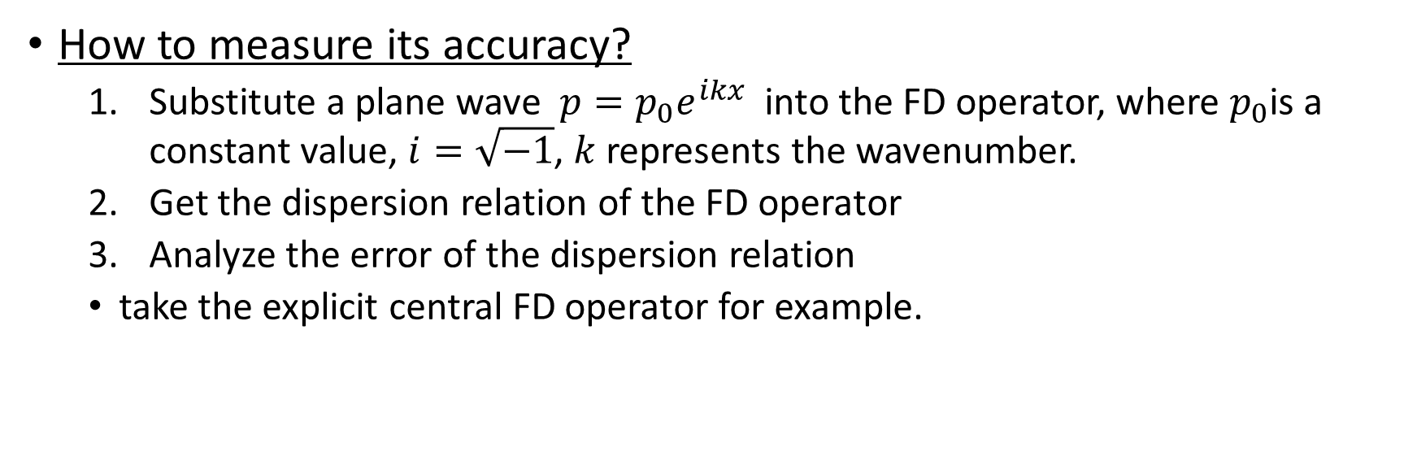
“implicit” FD operator
How to measure its accuracy?
  Substitute a plane wave $p=p_{0}e^{ikx}$ into the FD operator, where $p_{0}$is a constant value, $i=\sqrt{−1}$, $k$ represents the wavenumber.
  Get the dispersion relation of the FD operator
  Analyze the error of the dispersion relation
  take the explicit central FD operator for example.
Numeric dispersion relation
substitute
Notes:
How? Just three steps. 1, 2,3
Then we take ..for example.
Substitue this plane wave in to FD operator.
The left hand side equal to minus k square p, and the right hand side becomes this one. Finally we get this dispersion relation.
In theory, the left hand term should be equal to the right hand term. But because of the discretization, they are not equal.
We also note that this operator became this after substitute the plane wave.

Slide 7
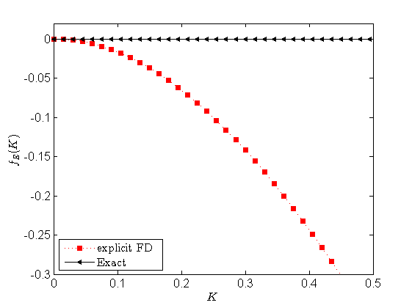
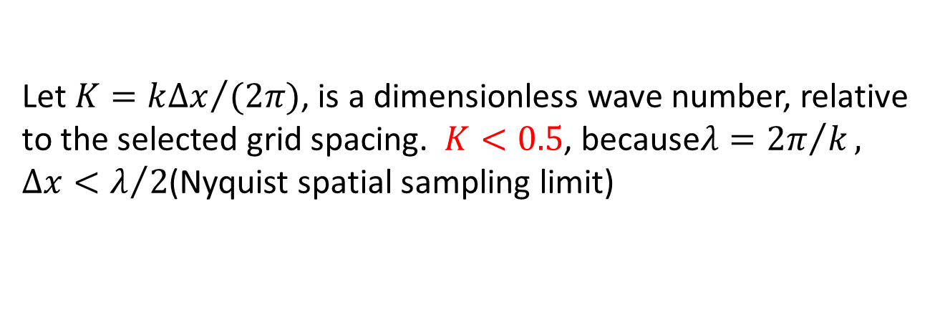
“implicit” FD operator
Numeric dispersion relation
  Let $K={k∆x}/{(2π)}$, is a dimensionless wave number, relative to the selected grid spacing. $K<0.5$, because$λ={2π}/k, ∆x<λ/2$(Nyquist spatial sampling limit)
Error function
Notes:
After we get this relation, we let K equal to kdx divide 2pi, it is a dimensionless wave number …. The relation between lambda and k, this N s s
We further simplified this dispersion relation.
Finally we get this error function. This function should be approximated zero.
So, we can measure the accuracy of a FD operator by analzing this error fuction.
This is the curve of the error function. We can see, at the larger K, the error increases. That meaing that with the increase of wavenumber for selected grid spacing, the error increase.

Slide 8
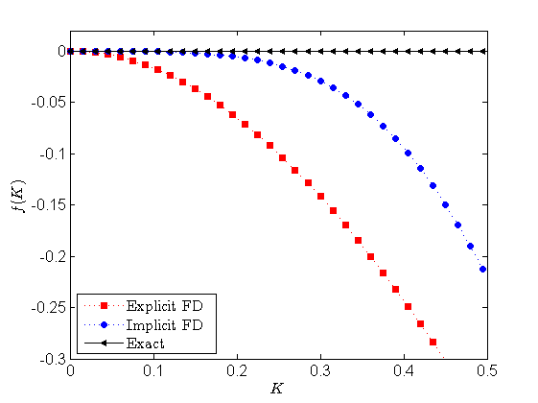
“implicit” FD operator
For the implicit FD operator
Its dispersion relation
obtained by TE method
Notes:
Just similarly, we can analyze this accuracy of the implicit FD operator. From this pic we can see the implicit FD operator can increase the accuracy compared with the explicit FD operator.

Slide 9

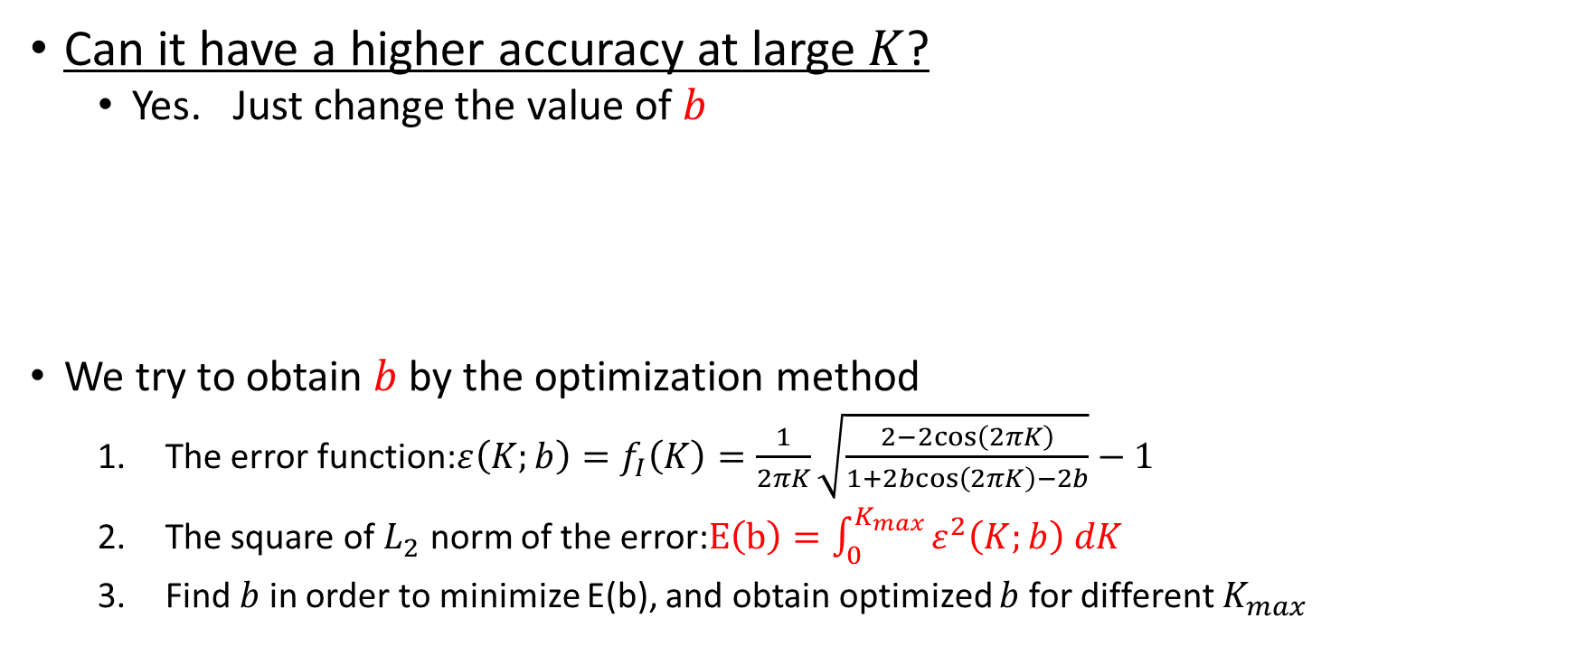
“implicit” FD operator
Can it have a higher accuracy at large $K$?
  Yes. Just change the value of $b$
  We try to obtain $b$ by the optimization method
    The error function:$ε\left(K;b\right)=f_{I}\left(K\right)=\frac{1}{2πK}\sqrt{\frac{2−2cos\left(2πK\right)}{1+2bcos\left(2πK\right)−2b}}−1$
    The square of $L_{2}$ norm of the error:$E\left(b\right)=\int_{0}^{K_{max}}{ε^{2}\left(K;b\right) dK}$
    Find $b$ in order to minimize E(b), and obtain optimized $b$ for different $K_{max}$
$$\frac{∂^{2}p}{∂x^{2}}≈\frac{\frac{δ^{\text{2}}p}{δx^{2}}}{1+bΔx^{2}\frac{δ^{\text{2}}}{δx^{2}}}$$

Slide 10
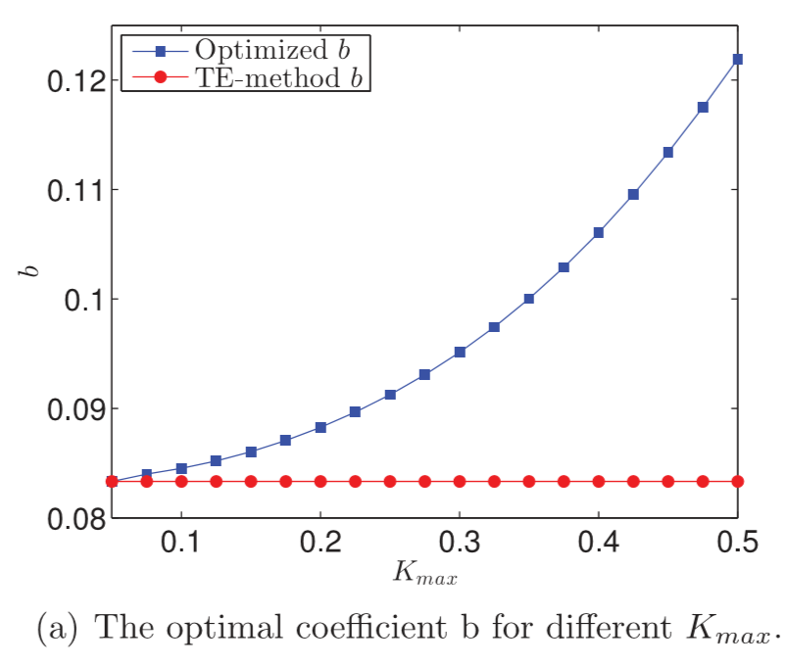
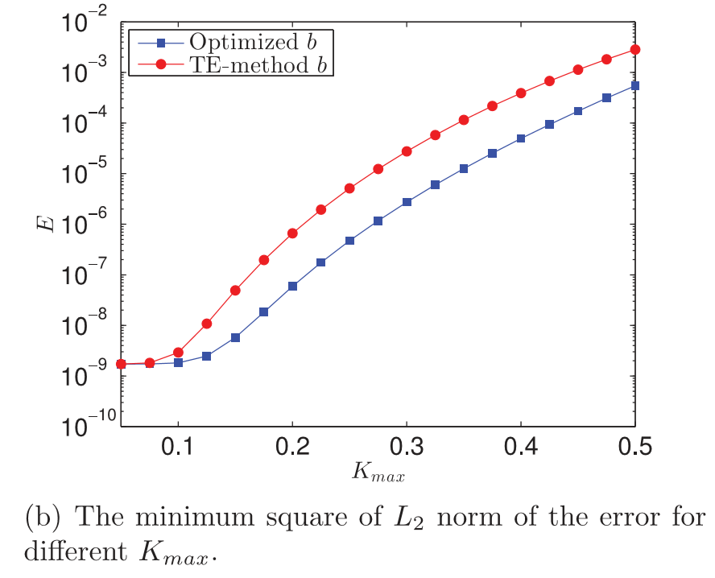
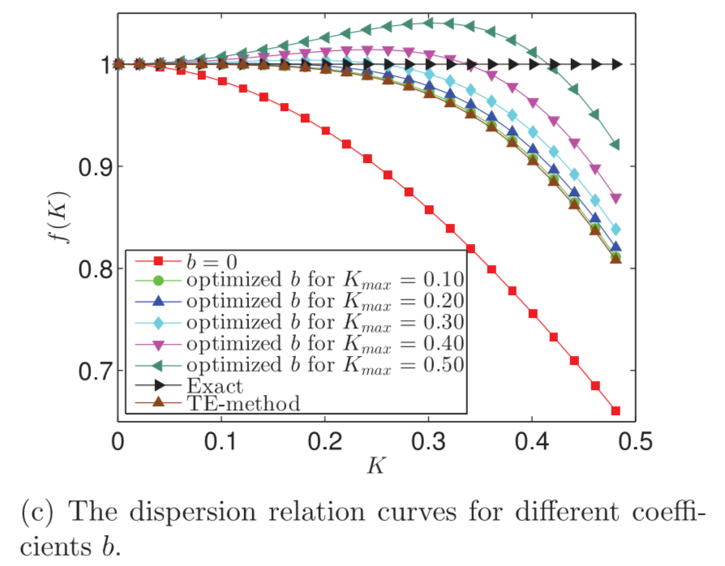
“implicit” FD operator
Notes:
optimization method can decrease the minimum values ofE(b) for different Kmax.
Fig. 2(c) shows that for the optimized coefficient the error in the dispersion relation is reduced at larger values ofK, while avoiding a dramatically decreasing accuracy for small values ofK.

Slide 11


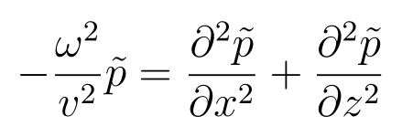




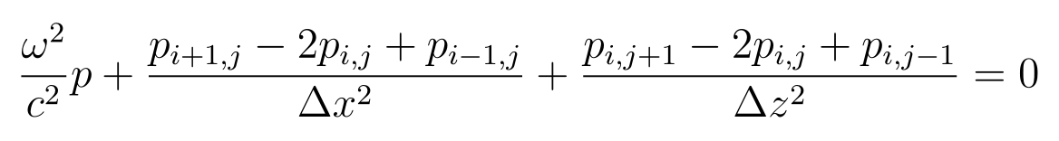
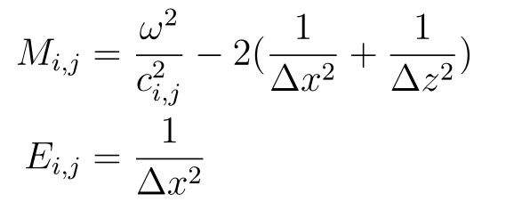
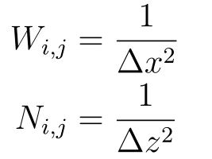
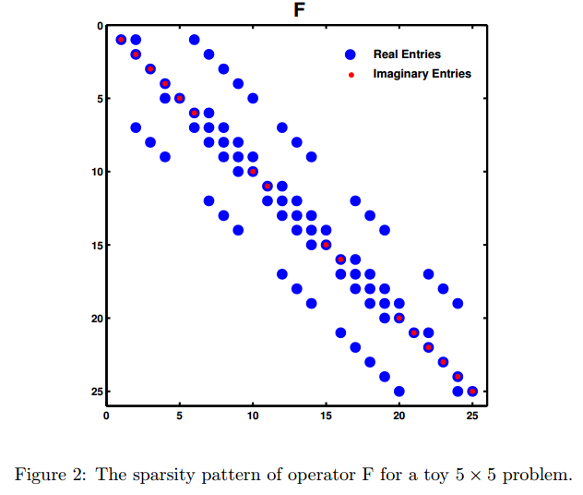
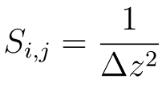
The optimized implicit FD scheme for the Helmholtz equation
The Helmholtz equation
Overview of the classical Five-point FD strategy
Symbolic abbreviation for element locations on a 5 point 2D FD stencil
Notes:
After the introduction of the implicit FD operator, we applied the implicit FD operator into the Helmholtz equation.

Slide 12
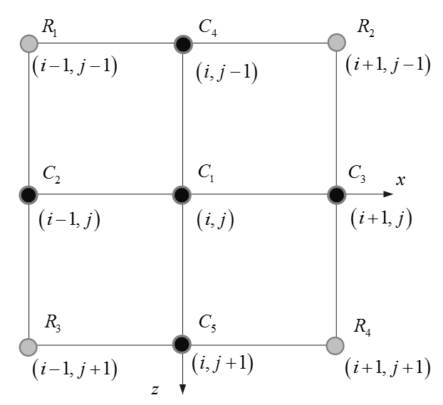

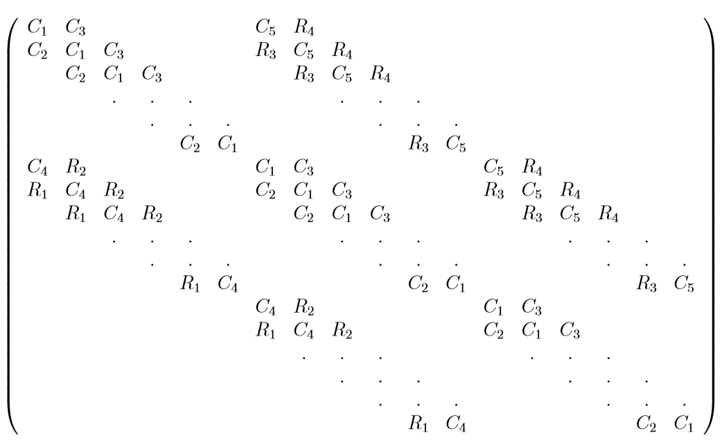

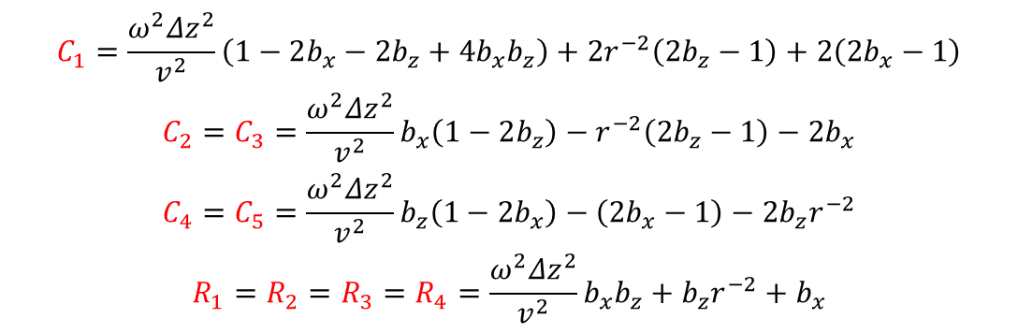
The optimized implicit FD scheme for the Helmholtz equation
The implicit 9-point FD scheme
  $\frac{\frac{δ^{2}}{δx^{2}}}{1+b_{x}^{1}Δx^{2}\frac{δ^{2}}{δx^{2}}}P+\frac{\frac{δ^{2}}{δz^{2}}}{1+b_{z}^{1}Δz^{2}\frac{δ^{2}}{δz^{2}}}P+\frac{ω^{2}}{v^{2}}P=s$
  Multiplied by$(1+b_{x}^{1}Δx^{2}\frac{δ^{2}}{δx^{2}})(1+b_{z}^{1}Δz^{2}\frac{δ^{2}}{δz^{2}})$, and obtain,
  $(1+b_{z}^{1}Δz^{2}\frac{δ^{2}}{δz^{2}})\frac{δ^{2}}{δx^{2}}P+ (1+b_{x}^{1}Δx^{2}\frac{δ^{2}}{δx^{2}})\frac{δ^{2}}{δz^{2}}P+\frac{ω^{2}}{v^{2}}\text{by}(1+b_{x}^{1}Δx^{2}\frac{δ^{2}}{δx^{2}})(1+b_{z}^{1}Δz^{2}\frac{δ^{2}}{δz^{2}})P=s$
  Where,
$$\begin{matrix}C_{1}=\frac{ω^{2}Δz^{2}}{v^{2}}\left(1−2b_{x}−2b_{z}+4b_{x}b_{z}\right)+2r^{−2}\left(2b_{z}−1\right)+2\left(2b_{x}−1\right) \\ C_{2}=C_{3}=\frac{ω^{2}Δz^{2}}{v^{2}}b_{x}\left(1−2b_{z}\right)−r^{−2}\left(2b_{z}−1\right)−2b_{x} \\ C_{4}=C_{5}=\frac{ω^{2}Δz^{2}}{v^{2}}b_{z}\left(1−2b_{x}\right)−\left(2b_{x}−1\right)−2b_{z}r^{−2} \\ R_{1}=R_{2}=R_{3}=R_{4}=\frac{ω^{2}Δz^{2}}{v^{2}}b_{x}b_{z}+b_{z}r^{−2}+b_{x}\end{matrix}$$
Notes:
Where the fourth mixed partial derivative can be expressed as this. We can see, it only need the value of p along the x and z axis. But also need the four corner point.

Slide 13
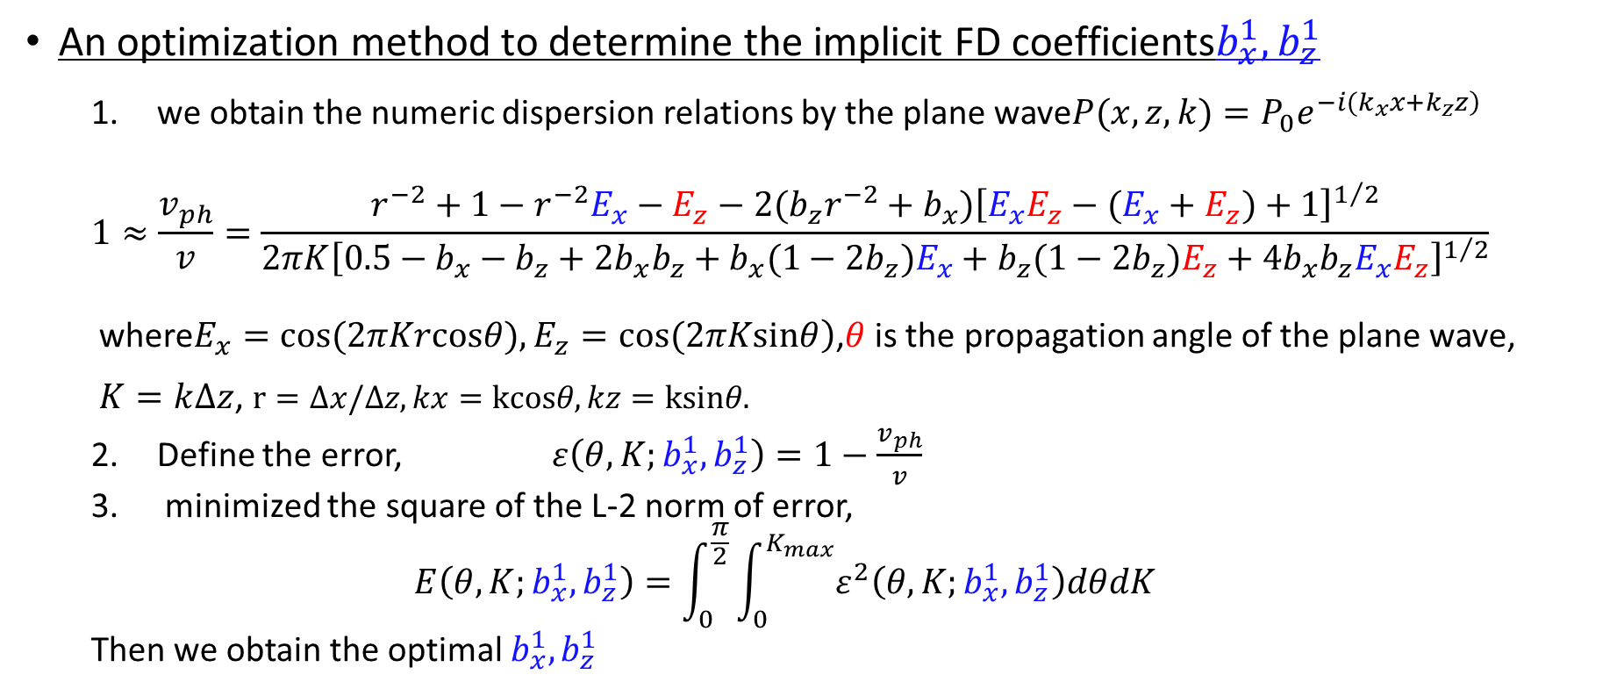
The optimized implicit FD scheme for the Helmholtz equation
An optimization method to determine the implicit FD coefficients$b_{x}^{1},b_{z}^{1}$
  we obtain the numeric dispersion relations by the plane wave$P(x,z,k)=P_{0}e^{\left.−i(k_{x}x+k_{z}z\right)}$
  $$1≈\frac{v_{ph}}{v}=\frac{r^{−2}+1−r^{−2}E_{x}−E_{z}−2(b_{z}r^{−2}+b_{x}){\left[E_{x}E_{z}−(E_{x}+E_{z})+1\right]}^{1/2}}{2πK{\left[0.5−b_{x}−b_{z}+2b_{x}b_{z}+b_{x}(1−2b_{z})E_{x}+b_{z}(1−2b_{z})E_{z}+4b_{x}b_{z}E_{x}E_{z}\right]}^{1/2}}$$
  where$\left.E_{x}=cos(2πKrcosθ),E_{z}=cos(2πKsinθ\right)$,$θ$is the propagation angle of the plane wave, $K=k∆z$, $r=∆x/∆z,kx=kcosθ,kz=ksinθ.$
  Define the error, $ε\left(θ,K;b_{x}^{1},b_{z}^{1}\right)=1−\frac{v_{ph}}{v}$
  minimized the square of the L-2 norm of error,
  $$E\left(θ,K;b_{x}^{1},b_{z}^{1}\right)=\int_{0}^{\frac{π}{2}}{\int_{0}^{K_{max}}{ε^{2}\left(θ,K;b_{x}^{1},b_{z}^{1}\right)dθdK}}$$
  Then we obtain the optimal $b_{x}^{1},b_{z}^{1}$
Notes:
Similar way to measure the FD operator?
The normalized phase velocity

Slide 14
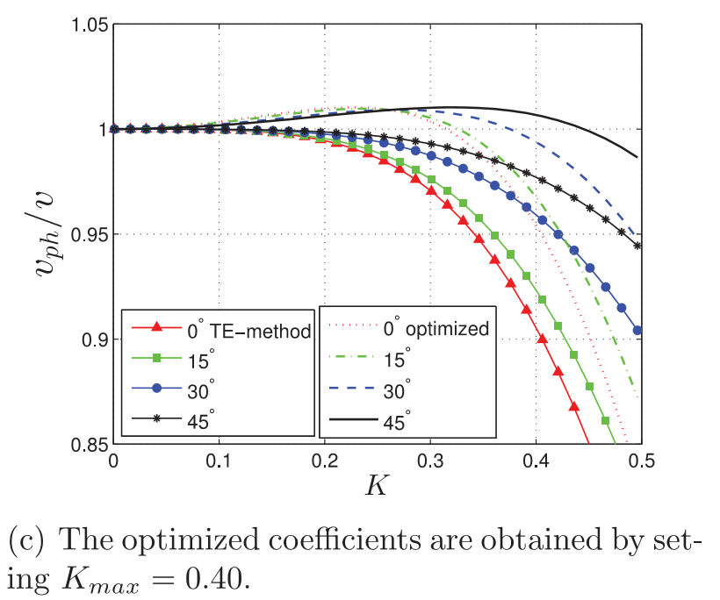

The optimized implicit FD scheme for the Helmholtz equation
$$b_{x}^{1},b_{z}^{1}=1/12$$
Notes:
This is the normalized phase velocity of different incident angles of plane,

Slide 15
The optimized implicit FD scheme for the Helmholtz equation
Numerical Experiments
  A homogeneous model with velocity 3000m/s
    We calculate the frequency domain wavefront at 1Hz,2Hz,…,100Hz
5Hz
40Hz
Non-optimized optimized
Non-optimized optimized
80Hz
100Hz
Non-optimized optimized
Non-optimized optimized

Slide 16
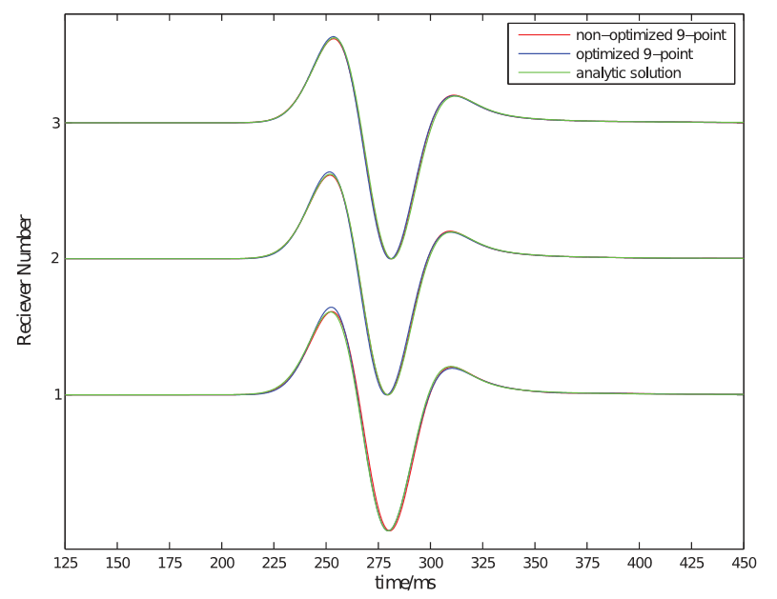
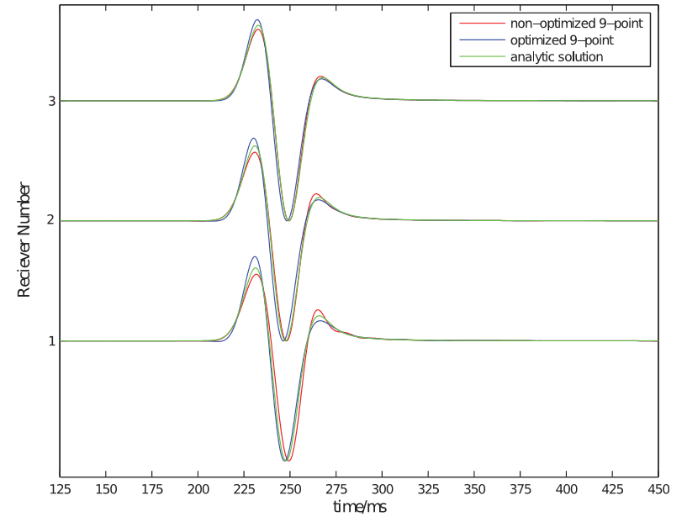
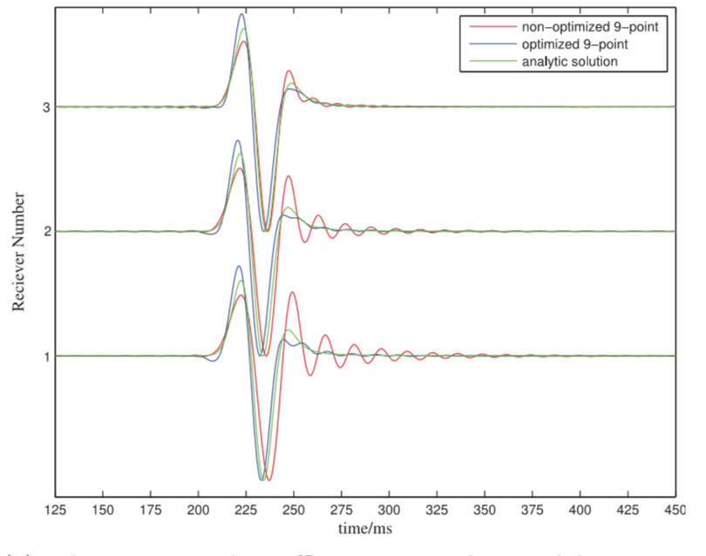
The optimized implicit FD scheme for the Helmholtz equation
how about the TD?
The amplitude spectrum of the Ricker sources with different centre frequencies
15Hz
25Hz
35Hz
Notes:
,First, we must use a source. And we choose three sources with different centre frequencies. We give the amplitude spectrum of these source. And we can see, with the increase of the centre frequency, the contribution of the small frequency become small. Our optimized coefficient can increase the accuracy at larger K.
where we modify the x-dimension label as the wavenumber for the selected grid spacing K from frequency f; dx=12m; velocity=3000m/s

Slide 17
The optimized implicit FD scheme for the Helmholtz equation
A three-layer model
Non-optimized optimized
100Hz
Non-optimized optimized

Slide 18
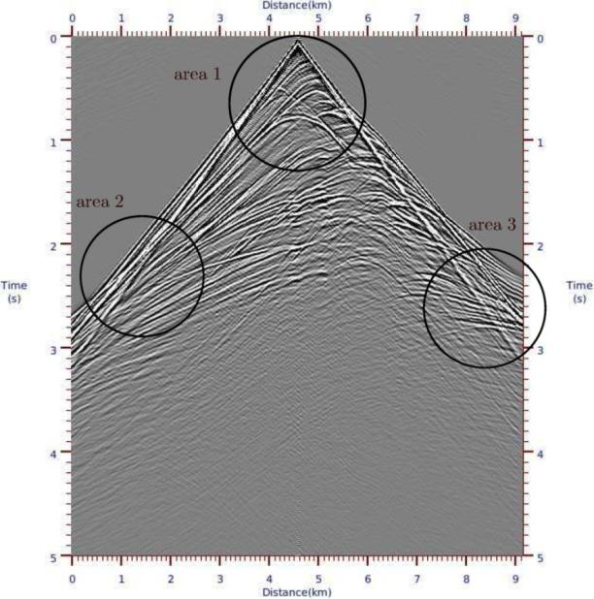
The optimized implicit FD scheme for the Helmholtz equation
The Marmousi Model
Area 1
Area 2
Non-optimized optimized
Non-optimized optimized
Non-optimized optimized
Area 3
Non-optimized optimized

Slide 19
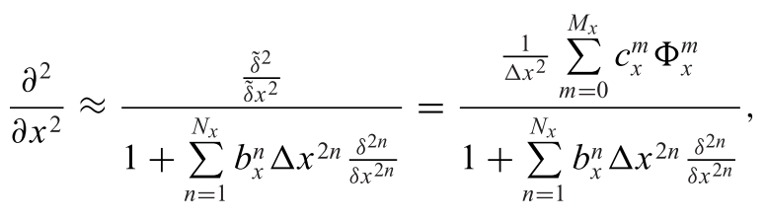
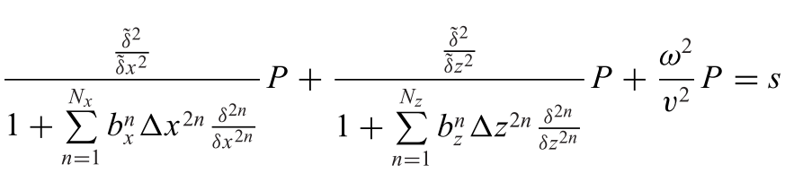
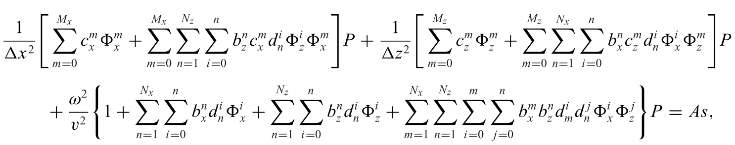
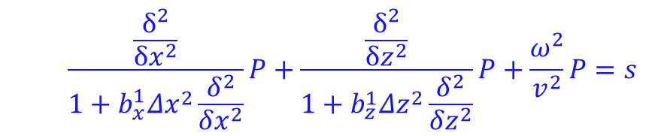
The optimized implicit FD scheme for the Helmholtz equation
An generic expression with arbitrary high-order accuracy
  $$\frac{\frac{δ^{2}}{δx^{2}}}{1+b_{x}^{1}Δx^{2}\frac{δ^{2}}{δx^{2}}}P+\frac{\frac{δ^{2}}{δz^{2}}}{1+b_{z}^{1}Δz^{2}\frac{δ^{2}}{δz^{2}}}P+\frac{ω^{2}}{v^{2}}P=s$$
Notes:
We also extend to a generic expression with arbitrary high-order accuracy.

Slide 20
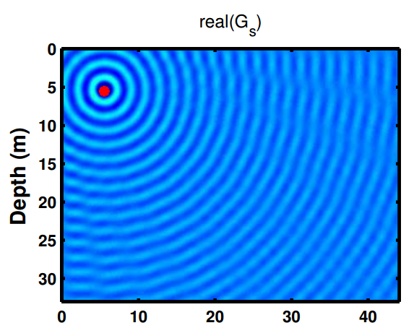
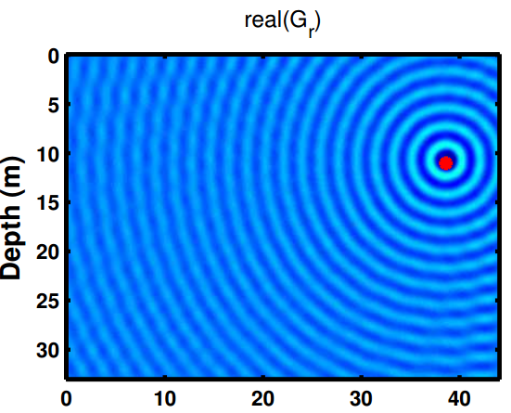
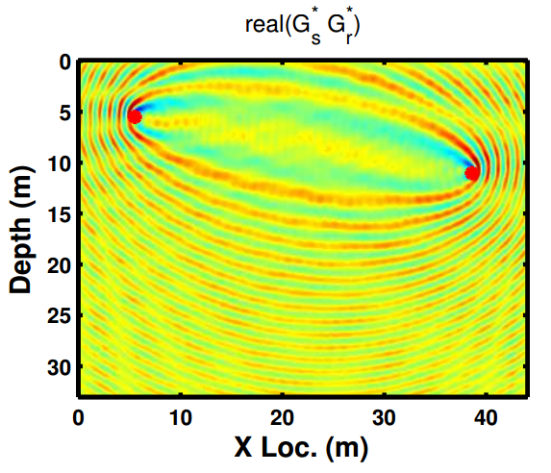
Future works
Get the optimized coefficients at each frequency component, not just the same ones in forward modeling(may increase accuracy further)
The consideration of parallel (easy to use)
Application in the migration and inversion(final goal)
the source Green’s functions
the receiver Green’s functions
the monochromatic wavepath (misfit gradient component) for the same S/R pair
References: Ajo-Franklin J B. Frequency-domain modeling techniques for the scalar wave equation: an introduction[J]. 2005.

